Slide 1

Project Topic:
Design of ISAC-Assisted Autonomous Platform Protocols
Current Specific Topic:
ISAC in Cell-Free Massive MIMO for Detecting and Sensing Autonomous Agents
Student Name: HABTE ENDALE LEGESSE
Student ID: 202412800033
Supervisor/Professor: Prof. KeFeng

Slide 2


01
ISAC in Cell-Free Massive MIMO
02
Multi-Static Sensing & Detection
目
录
03
Joint Optimization of Power & Sensing Duration
04
Algorithm, Performance Metrics & Simulations
05
Challenges & Future Directions

Slide 3


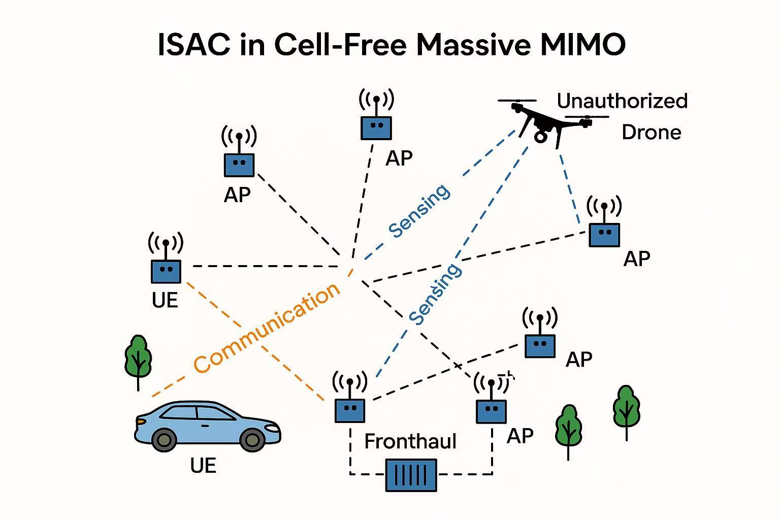
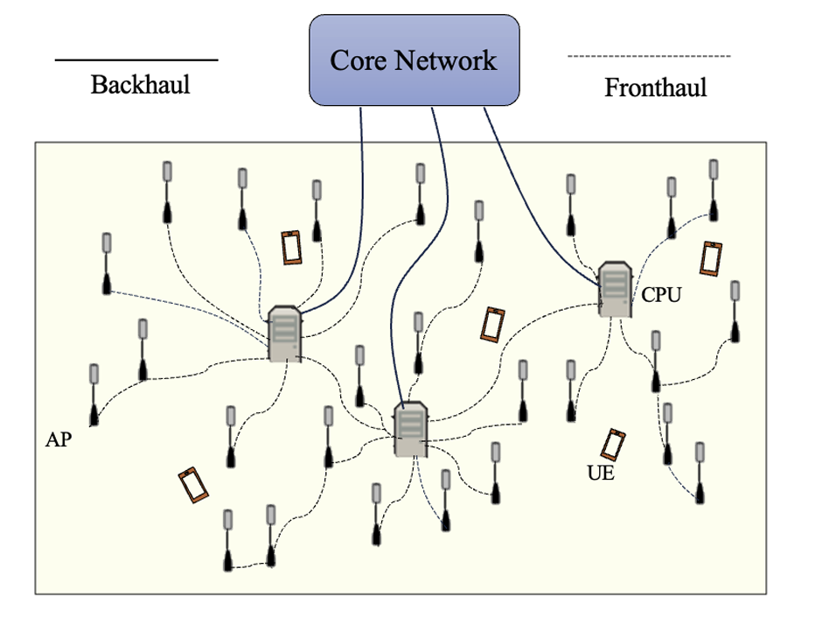
ISAC in Cell-Free Massive MIMO
01
Integrated Sensing and Communication
Integration of terrestrial and non-terrestrial networks
Sensing terrestrial and aerial targets
Sensing information will be used for automation, safety, new sensing-based applications, monitoring, communication…etc.
Sensing can benefit from multi-connectivity and joint transmission and reception and distributed APs in cell-free massive MIMO systems

Slide 4
Main ISAC Outlooks in cell-free massive MIMO
Developing sensing algorithms with a focus on multi-static sensing
Maximum Posterior Ratio Test Detectors (MAPRT)
Multiple target detectors
Clutter-aware, clutter-unaware detectors
Distributed/centralized detectors
Resource allocation algorithms
Transmission and end-to-end power/energy minimization
Joint power and blocklength optimization for short packet transmission in URLLC
AP operation mode selection algorithms in cell-free massive MIMO systems
For mmWave cell-free systems
For multi-target scenarios
Sensing performance metrics
Detection probability
False alarm probability
Sensing update rate
Sensing coverage
Age of sensing (AoS)
Fronthaul signaling load

Slide 5
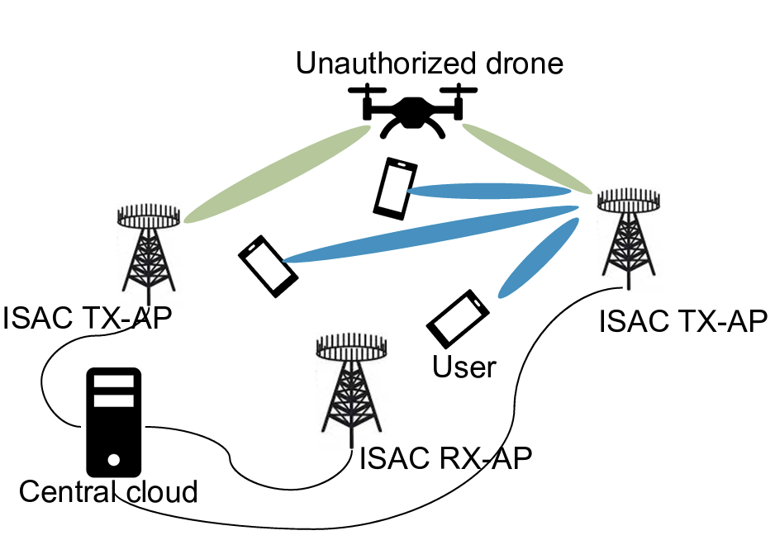
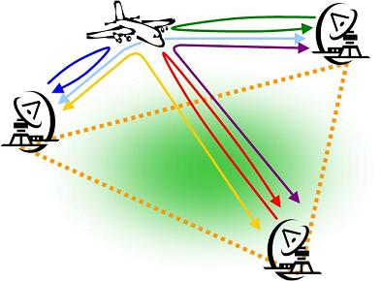
Multi-Static Sensing & Detection
02
Cell-Free Massive MIMO
Multi-static Sensing
Cell-free massive MIMO uses distributed APs coordinated by a central unit—no traditional cells
Multi-static sensing enables target detection via spatially distributed transmitters and receivers.
Enhances target detection, localization accuracy, and network-wide sensing coverage
Ideal for applications like unauthorized drone detection and security monitoring.

Slide 6

Multi-Static Sensing & Detection
How to obtain fresh sensing information with a good coverage?
ISAC for Unauthorized Drone Detection
Challenges
• Resource sharing between communication and sensing
• Dynamic environment necessitates fast sensing with high coverage
Main Goals
High precision (High sensing coverage)
Freshness of the sensing updates (Low age of sensing information)
Li X, Behdad Z, Topal OA, Demir ÖT, and Cavdar C, Detecting Unauthorized Drones with Cell-Free Integrated Sensing and Communication, Accepted in IEEE WCNC 2025

Slide 7
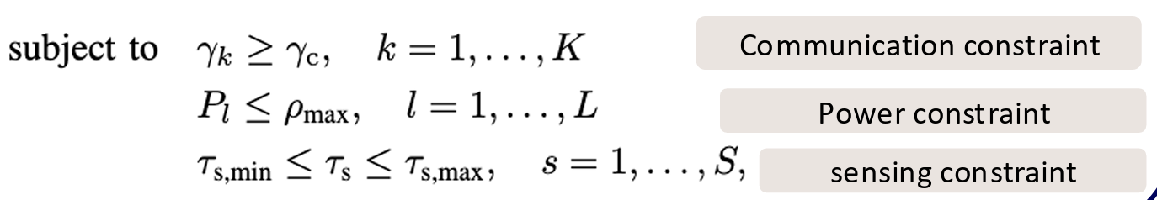
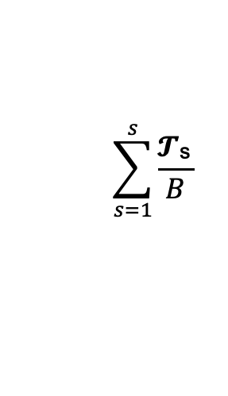
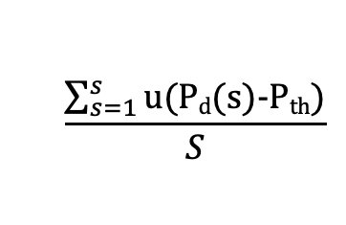
Joint Optimization of Power & Sensing Duration
03
Objective
Jointly maximize sensing coverage and minimize AoS while meeting the communication, sensing, and power requirements.
Communication:
Sensing:
Needs low latency, specially in short –packet scenarios
Needs sufficient blocklength and power for reliable transmission.
Needs enough time and power to detect and localize objects.
More power or blocklength for sensing → improves detection range & accuracy → but reduces availability for communication.
More resources for communication → improves user QoS → but sensing becomes less frequent or less accurate.
The Trade-off
Joint power and sensing duration/blocklength allocation!
Optimization!
,
𝜔₁
𝜔₀
optimization weights
:
Sensing Coverage
AoS
$$\sum_{s=1}^{s}{\frac{\text{𝓣}\text{ˢ} }{B}}$$
Maximize
𝜔₀
$$\frac{\sum_{s=1}^{s}{\text{u}\text{(}\text{Pd}\text{(}\text{s}\text{)-}\text{Pth}\text{)}}}{S}$$
𝜔₁
𝓣_{ˢ}
{𝘗 _{𝑘}} _{𝑘=0} ^{𝑘}

Slide 8
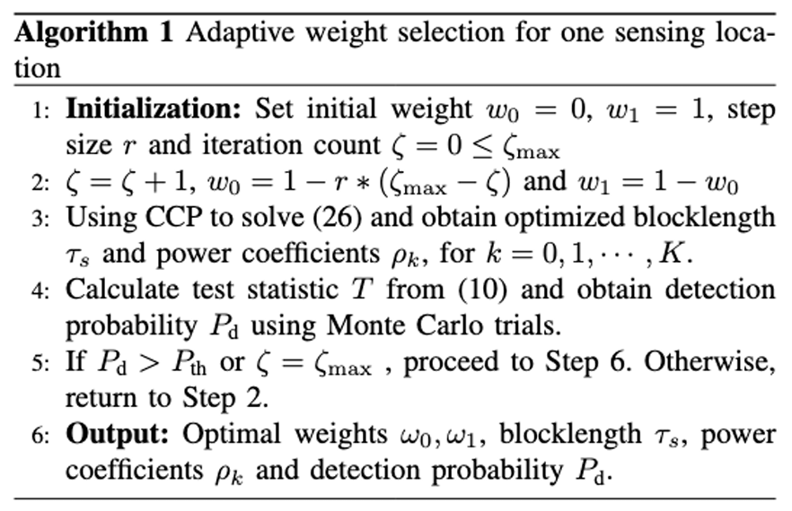
Algorithm, Performance Metrics, & Simulations
04
Adaptive Weight Selection Algorithm
Iterative algorithm to optimize the blocklength and power individually for each candidate location by optimizing the weights.
Start with a focus on minimizing AoS by setting zero weight for sensing coverage (𝜔₀ = 0)
Gradually increase the weight for sensing coverage and decrease the weight for AoS until detection probability exceeds the threshold (P_{d} > 𝑃_{𝑡ℎ})
Stop the iteration if Pd > 𝑃𝑡ℎ or the number of iteration reaches its maximum value

Slide 9
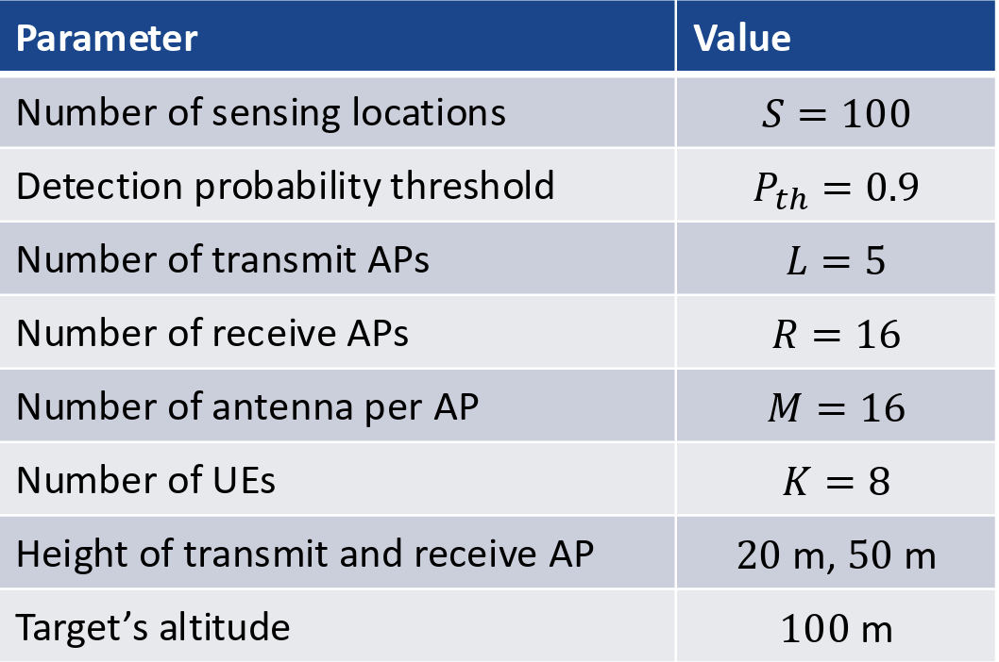
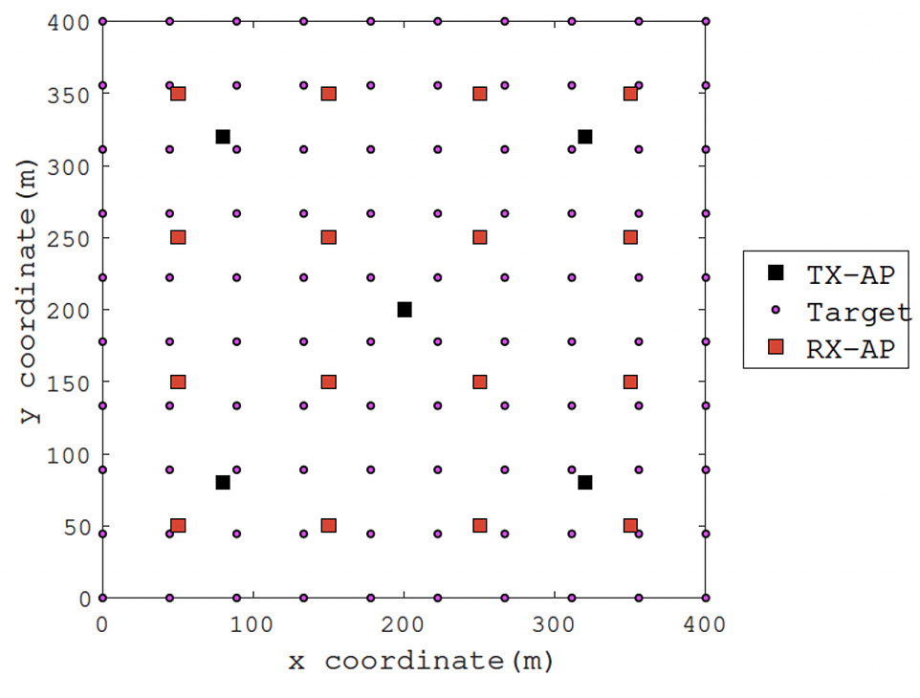
04
Performance Metrics

Slide 10
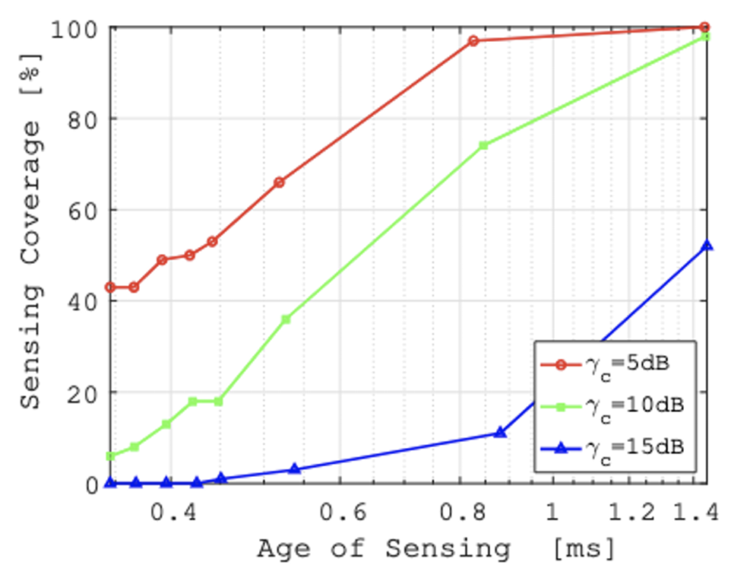
04
Simulations Results
Sensing coverage increases with longer sensing durations
Higher SINR thresholds, reduce sensing coverage due to the need for higher power allocation for terrestrial UEs, leaving less power for sensing.

Slide 11
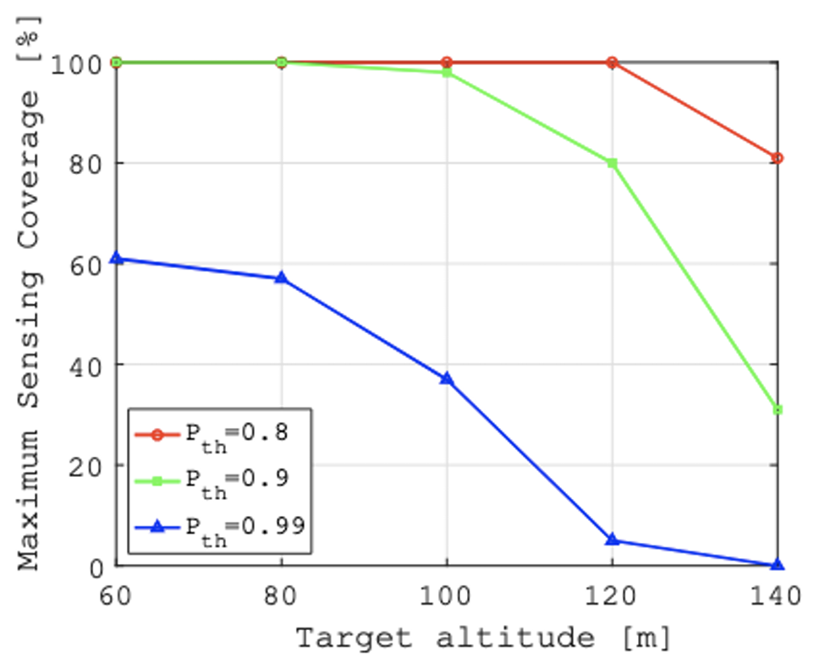
04
Simulations Results
Sensing coverage decreases as altitude rises
The most stringent threshold, 𝑃𝑡ℎ = 0.99, shows the steepest drop, starting at about 60% coverage and quickly decreasing to near zero at higher altitudes

Slide 12
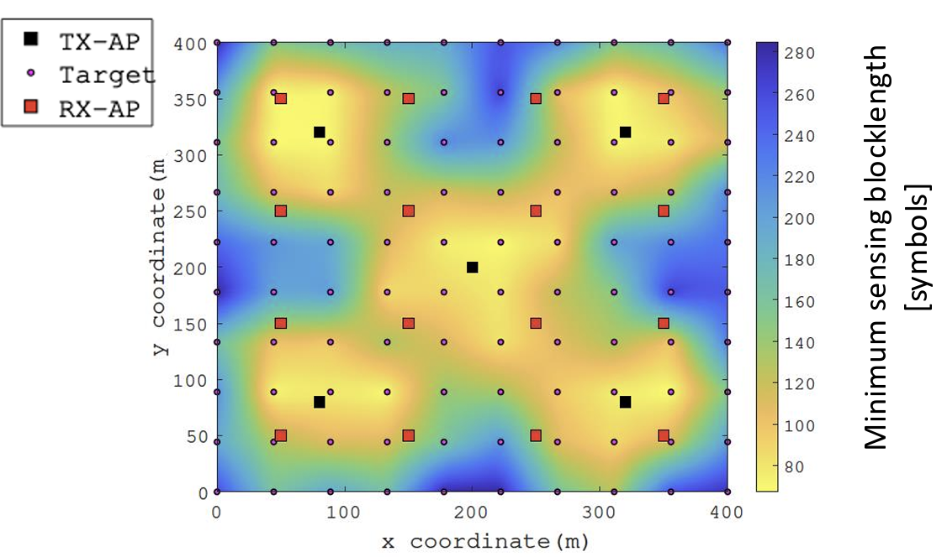
04
Simulations Results
As the distance from the APs increases, the blocklength becomes considerably longer, reaching its maximum in the corner regions to meet the detection probability threshold.
This demonstrates the spatial dependency of sensing performance on proximity to the transmit APs

Slide 13
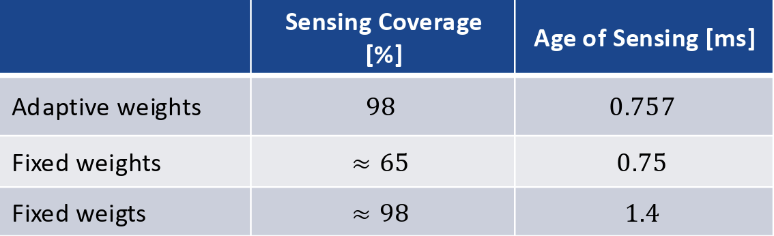
04
Comparison of sensing coverage and age of sensing
The results demonstrate the advantage of the proposed algorithm, achieving up to a 45% reduction in AoS compared to using fixed weights.
To achieve the same 98% coverage with fixed weights, the total sensing time increases significantly to 1.4 ms.

Slide 14
Conclusion
Proposed a cell-free massive MIMO-ISAC framework that aims to detect unauthorized drones.
The proposed framework jointly optimizes the power coefficients of communication and sensing signals, and the sensing blocklength to balance between two main goals:
Precision
Timeliness
while guaranteeing communication requirements.
The results demonstrate that the proposed adaptive weight selection algorithm results in 45% reduction in age of sensing, while maintaining over 98% sensing coverage, demonstrating the efficient utilization of the resources.

Slide 15
ISAC in Cell-Free Massive MIMO
05

